Slide 1

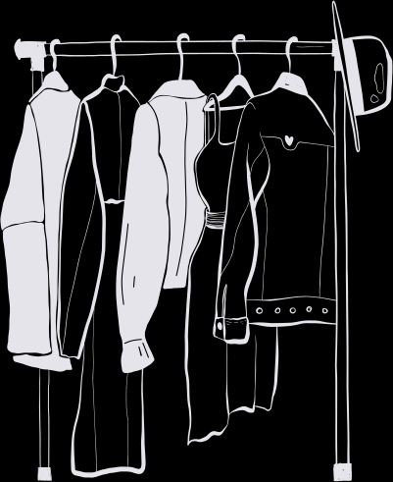


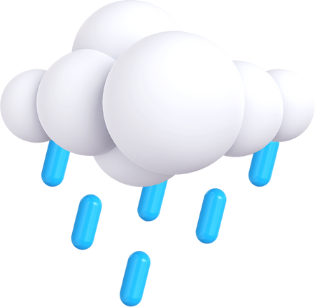


WEATHER WEAR
Presented By Team - 3
Bad Ideas

Slide 2


AGENDA
1
Team Members Roles and Responsibilities
Stories not completed
7
Technologies
13
Improvements made from Professor Feedback
14
Metrics
2
8
Algorithms
15
Retrospective
3
Project Description
9
Diagrams and Recap
16
Sprint 3
Team Working Agreement
10
4
Product backlog
8
17
Project Demo
5
Personas
11
Test Cases
18
Github Link
6
6
MVP
12
Stories Completed
19
Live Application Demo

Slide 3

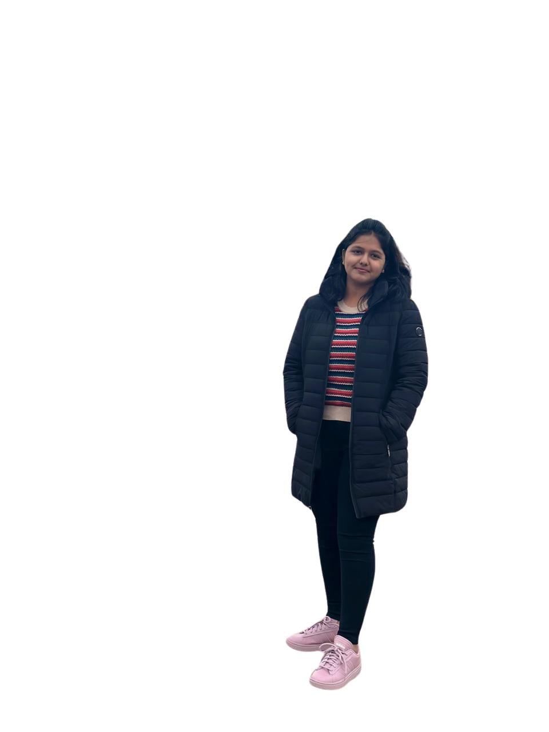
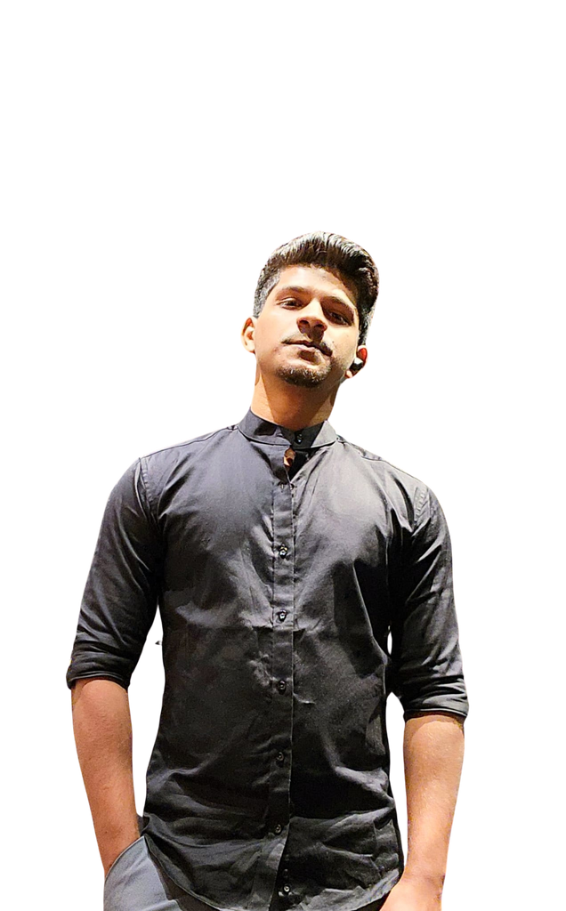
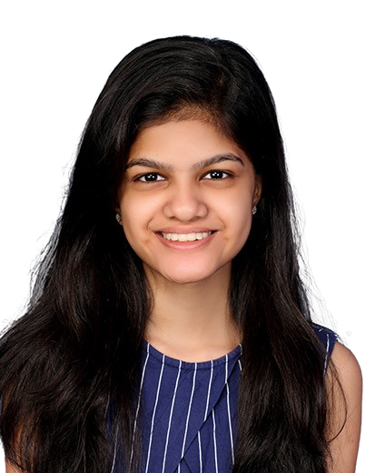

THIS IS OUR TEAM
Helloween James
Gracia Betty Jebaraj Daniel
Tejaswini Kandyala
Project Manager & Machine Learning Engineer
Frontend Developer
Frontend Developer & UI/UX Designer

Slide 4
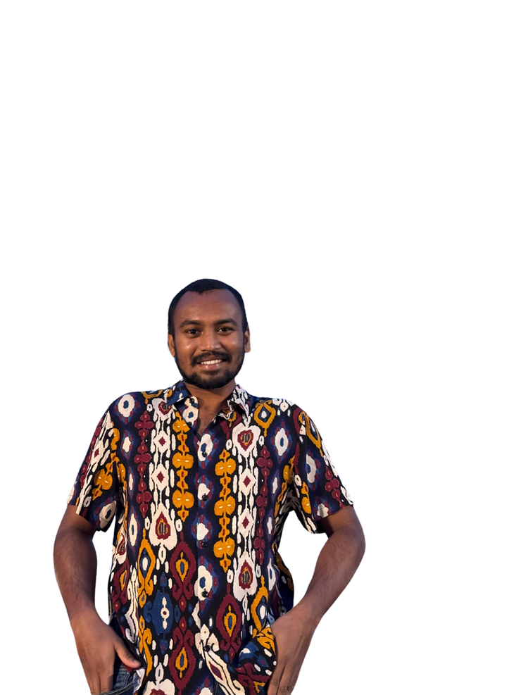
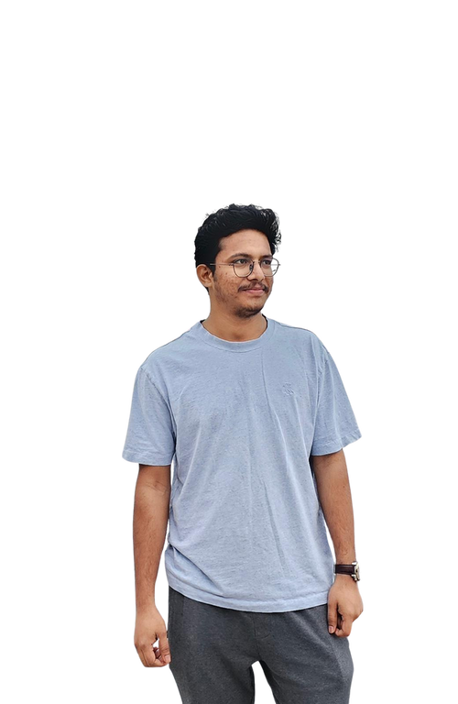
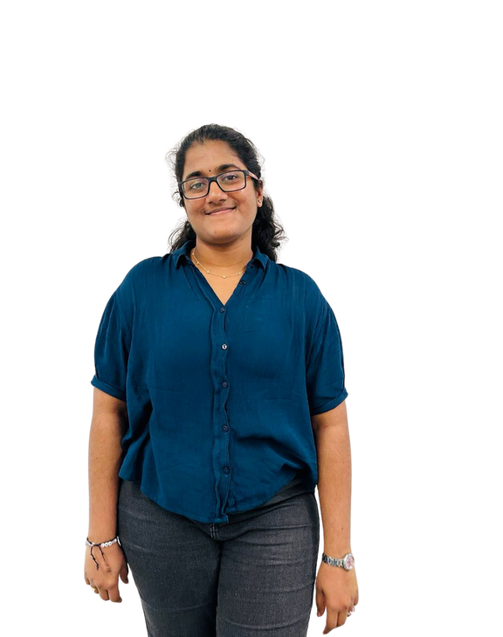
THIS IS OUR TEAM
Bharadwaj Reddy Asireddy
Mohith Durga Srinivas Tripuramallu
Sai Rajeswari Ghanta
Backend Developer & UI/UX Designer
Quality Assurance Tester
Backend Developer

Slide 5

Improvements made from professor feedback
Using specific name for the user stories.
Aligning the diagrams order.
Adding proper user id and test case id.
Addition of user benefits.

Slide 6
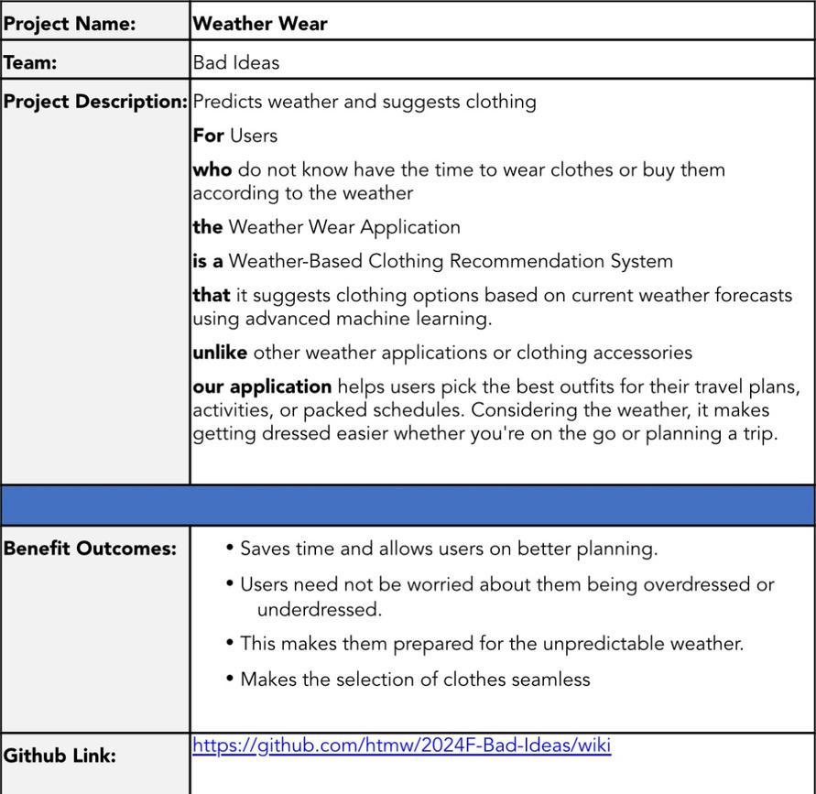
PROJECT DESCRIPTION

Slide 7

TEAM AGREEMENT
1. Team Information
· Project Title: Weather Wear
· Team Name: Bad Ideas
· Team Members and Roles :
Helloween James – Project Manager & Machine learning engineer
Gracia Betty Jebaraj Daniel – Front-end developer & UI/UX Designer
Tejaswini Kandyala – Front-end developer
Mohith Durga Srinivas Tripuramallu – Back-end Developer
Bharadwaj Reddy Asireddy - Back-end Developer & UI/UX Designer
Sai Rajeswari Ghanta - Quality Assurance (QA) Tester
2. Meetings and Communication
We will meet twice a week and we shall use what’s app, email, outlook and Zoom as our communication for any updates and response should be within 2-3hrs.
3. Work Distribution
Everyone in the team agrees to share the work equally and if any member fells overwhelmed, we will redistribute the tasks.

Slide 8
TEAM AGREEMENT
4. Conflict Resolution
· If we have any sort of disagreement in the tasks, we’ll talk it through vote.
· If the conflict cannot be resolved internally, we will reach professor for an advice
5. Deadlines
· We will set deadlines for each task and everyone agrees to stick to them and if someone can’t meet a deadline, they should inform the team in advance.
· We agree to submit everything on time, with everyone’s contribution.
6. Signatures
· Gracia Betty Jebaraj Daniel
· Tejaswini Kandyala
· Helloween James
· Mohith Durga Srinivas Tripuramallu
· Bharadwaj Reddy Asireddy
· Sai Rajeswari Ghanta

Slide 9

PERSONAS

Slide 10
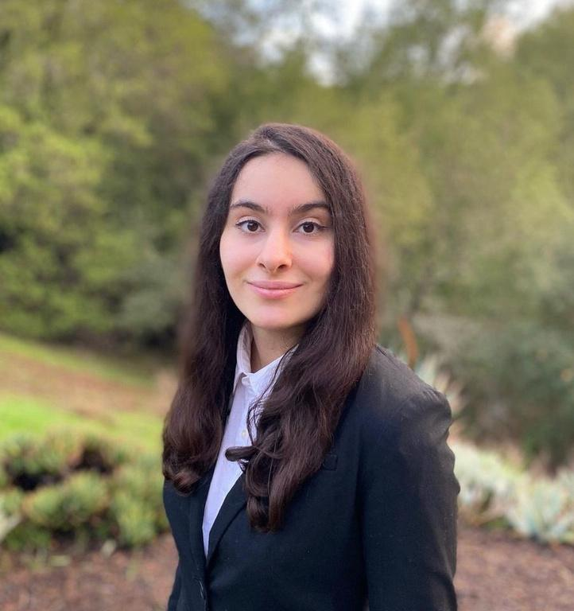
HANNAH
This is Hannah, Age 28. She stays in New York City, NY and she is Product Manager.
Life Style: She commutes everydays and she meets a lot of clients.
Weather and Clothing: NYC weather is totally unpredictable as it can rain, be sunny or be cold anytime. She likes wearing formal clothes.
Technology usage: She loves trying out new apps.
She is busy person and always wears uncomfortable dress which does not align well with weather, so she needs something which can set her to wear clothes which doesn't waste her time.

Slide 11

JASON
This is Jason, Age 34. He stays in Seattle, WA, and he is a Software Engineer.
Life Style: He commutes to the office twice a week and enjoys biking when the weather permits.
Weather and Clothing: Seattle's weather is unpredictable, with frequent rain and sudden changes. He prefers casual and comfortable clothing but often finds himself either underdressed for cold weather or overdressed when it warms up unexpectedly.
Technology usage: He is tech-savvy and enjoys trying out new apps to improve efficiency.
He frequently faces issue with choosing the right clothes due to the constant change in weather and he needs a solution that helps him dress appropriately for the day.

Slide 12

ANANYA
This is Ananya, Age 22. She stays in Mumbai, India, and she is a College Student.
Life Style: She walks around campus a lot, balancing her classes, internships, and extracurricular activities.
Weather and Clothing: Mumbai's weather can be unpredictable, with sudden rain showers or humid heat. She likes trendy, comfortable clothes but struggles to dress appropriately when the weather changes quickly.
Technology usage: She uses multiple apps to manage her busy schedule and lifestyle.
She often finds herself either drenched in rain or overheated due to sudden weather changes and needs something that will help her choose the right outfit for the day without wasting time.

Slide 13

Minimum Viable Product
Location-Based Weather Data: Fetch and display real-time weather.
Outfit Suggestions: Recommend outfits based on weather.
Future Outfit Planning: Plan outfits for future dates.
User Preferences: Customize outfit recommendations.
Responsive Design: Optimized for mobile and desktop.

Slide 14



TECHNOLOGIES
Frontend
Backend
Database
Next JS
Shadcn
Tailwind CSS
Flask
Open weather API
MongoDB

Slide 15
TECHNOLOGIES
Machine
Learning
Tools
Deployment
Figma
VSCode
Codespaces
Github
Postman
Vercel
AWS
Scikit Learn
Pytorch

Slide 16


ABOUT FRONTEND TECHNOLOGIES
So here next js is used for building the website because next js is one of the best frontend frameworks and with integration with shadcn and tailwind css, building minimalistic website easier.

Slide 17

ABOUT BACKEND TECHNOLOGIES
RapidAPI offers a variety of weather APIs that provide all the data you could need. These APIs are great for delivering accurate and up-to-date weather information.
For our project, we chose one of these weather APIs from RapidAPI to boost our data capabilities.

Slide 18

ABOUT DATABASE TECHNOLOGIES
MongoDB is one the best NoSQL database and as the application data can also be unstructured, this would be best option to choose it. This also have fast retrieval ( read operations) compared to SQL databases, so this is better choice for this application.

Slide 19

ABOUT DEPLOYMENT TECHNOLOGIES
Here, first vercel is used for deploying the frontend part of the application and aws is used for deploying backend and machine learning as well because NextJS works seamless in vercel, as vercel are the one who developed Next js.

Slide 20

ABOUT MACHINE LEARNING TECHNOLOGIES
So here scikit learning is primarily used for building the basic version of the machine learning algorithms and in later on stages, Pytorch is used for build even more accurate version of the machine learning which understands the weather even more better and predicts it well.

Slide 21

ABOUT TOOLS TECHNOLOGIES
Figma is mainly used for prototyping and design how the product looks like. VSCode is where actually the code is written. Codespaces is where the collaboration code is done, for pair programming. Github is where whole code is hosted. Postman is for testing the API endpoints.

Slide 22
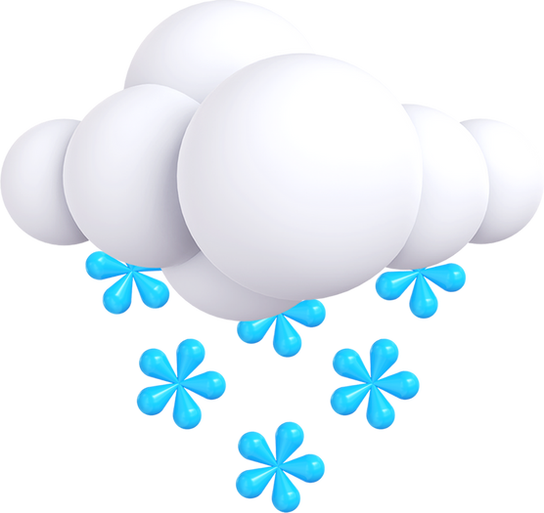
ALGORITHMS
Predicting Weather
Random forest regressor
Used to predict weather conditions like temperature or humidity by learning patterns from historical weather data through decision trees that capture non-linear relationships.
LSTM
A recurrent neural network used to predict future weather by capturing long-term dependencies and patterns in sequential weather data over time.
Recommendation
KNN (k-nearest neighbours)
Used to recommend outfits by finding similar users (or outfits) based on user preferences and weather conditions, suggesting clothing choices that worked for users with similar profiles or conditions.

Slide 23
DIAGRAMS

Slide 24
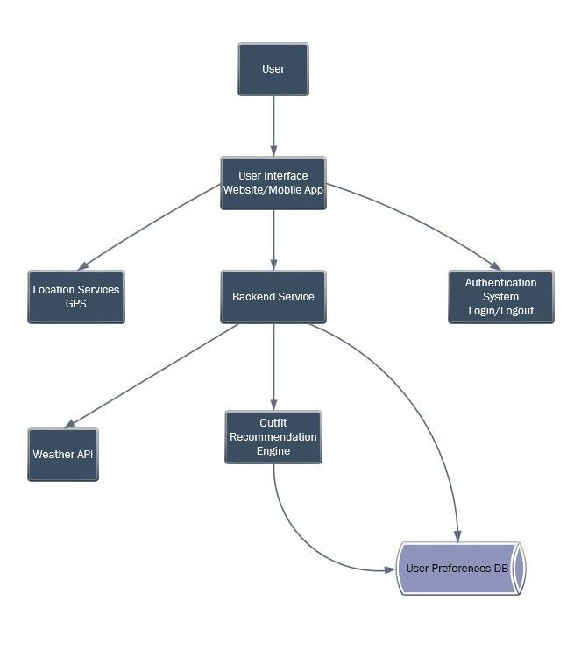
Architecture diagram

Slide 25
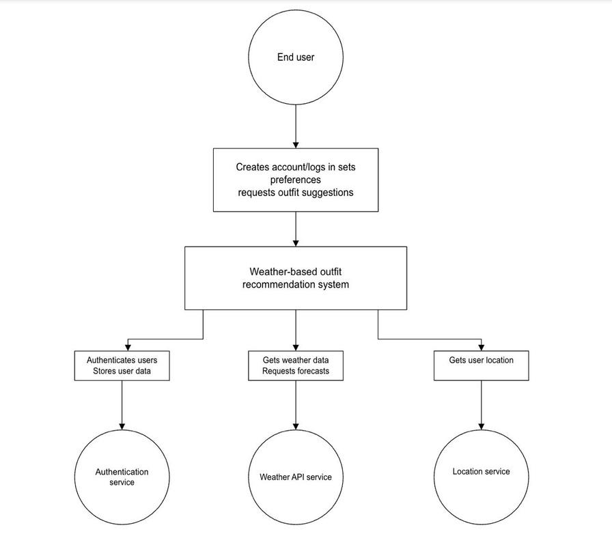
Context diagram

Slide 26
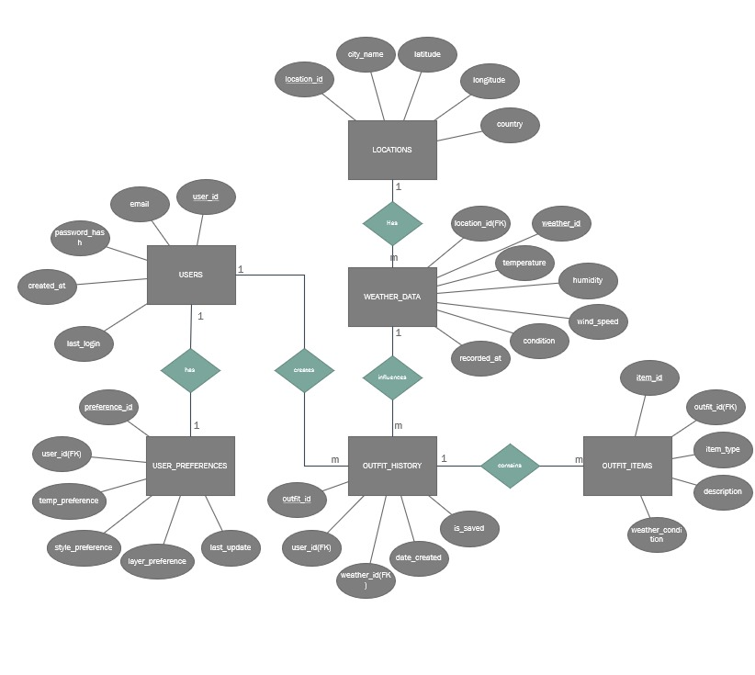
ER diagram

Slide 27
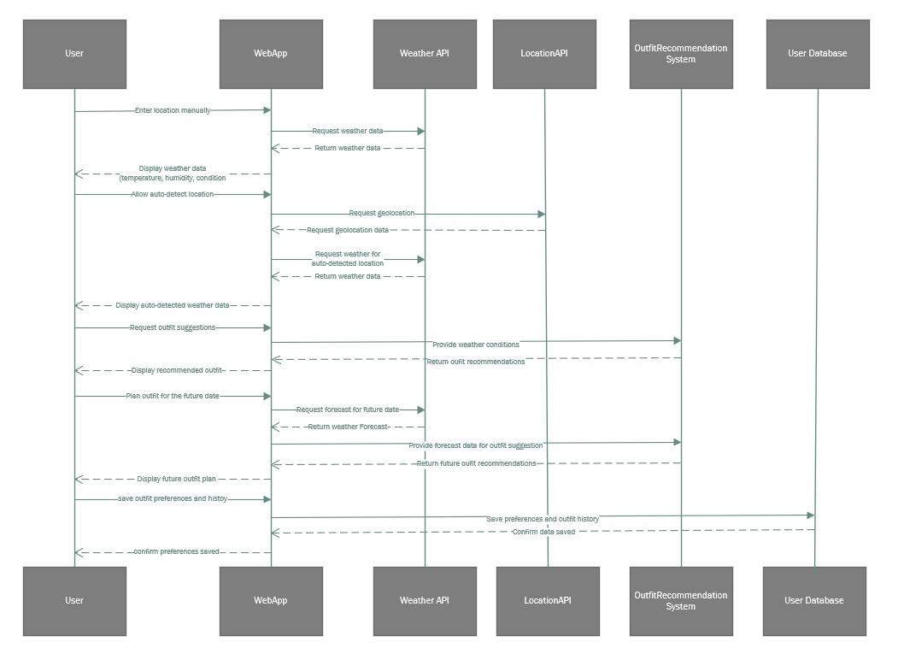
Sequence diagram

Slide 28
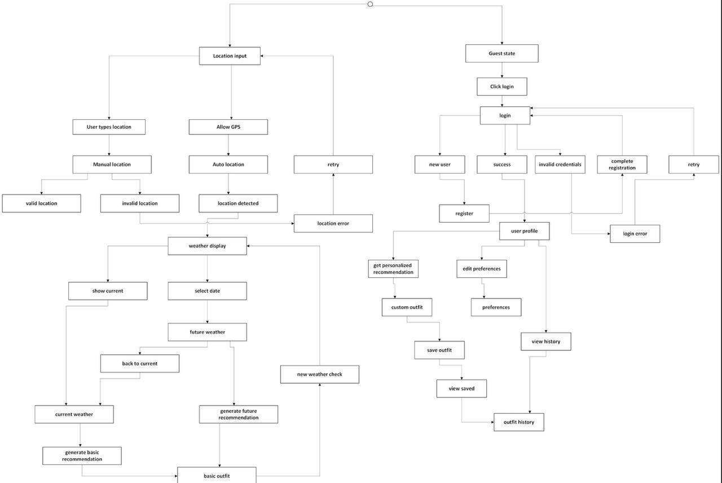
State Diagram

Slide 29
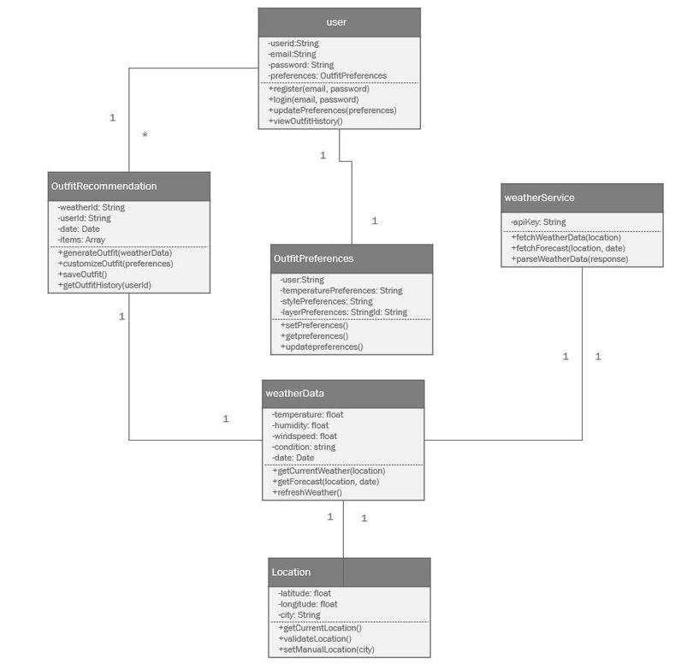
Class diagram

Slide 30
Sprint 1 Recap
In Sprint 1, we enabled real-time weather data input, location auto-detection, a user-friendly display, and mobile responsiveness, integrating a weather API with error handling for accurate, accessible information.

Slide 31
Product Backlog
Story ID | User Story | User Benefit
US 1.1 | As a weather enthusiast, I want to input my current location to get real-time weather data. | Access real-time weather information for any chosen location. | 1. User can input location manually. 2. User can choose from predefined cities. 3. System displays temperature, humidity, and weather condition. 4. Graceful error handling for invalid locations.
US 1.2 | As a business professional, I want the system to detect my location automatically to quickly get weather info. | Save time by receiving instant, location-based weather updates. | 1. Option to enable location-based weather. 2. System requests geolocation permission. 3. Automatic weather data retrieval. 4. Graceful handling when permission is denied.
US 1.3 | As a traveler, I want to see basic weather details clearly on the homepage. | View essential weather info at a glance while on the go. | 1. Temperature, humidity, wind speed, and weather condition are displayed clearly. 2. Simple, user-friendly layout.
Acceptance Criteria

Slide 32
Product Backlog
Story ID | User Story | User Benefit | Acceptance Criteria
US 1.4 | As a weather enthusiast, I want to refresh weather data manually. | Get up-to-date weather information whenever needed. | 1. Refresh button for manual data refresh. 2. Latest weather information displayed.
US 1.5 | As a business professional, I want the website to be responsive on mobile devices. | Access weather information comfortably on any device. | 1. Responsive layout for desktop and mobile. 2. Weather data clearly visible on all devices.
TS 1.1 | As a UI/UX designer, I want a basic layout for weather data display. | Enable intuitive weather data interaction for users. | 1. Homepage with location input fields and refresh button. 2. Clear, organized weather data display.
Acceptance Criteria

Slide 33
Product Backlog
Story ID | User Story | User Benefit | Acceptance Criteria
TS 1.2 | As a backend developer, I want to integrate a weather API to fetch real-time weather data. | Provide reliable and accurate weather data for users. | 1. Successful data retrieval from an external API. 2. Stable API integration. 3. Error handling for invalid locations.
US 2.1 | As a weather enthusiast, I want to receive an outfit suggestion based on current weather conditions. | Dress appropriately for the weather. | 1. Outfit suggestion for cold, warm, rainy, snowy, and windy conditions.
US 2.2 | As a traveler, I want to prepare an outfit for a future date or journey. | Plan ahead for upcoming weather conditions. | 1. Future date input for weather forecasts. 2. Outfit suggestions based on future weather. 3. Time of day selection for accuracy.
Acceptance Criteria

Slide 34
Product Backlog
Story ID | User Story | User Benefit | Acceptance Criteria
US 2.3 | As a business professional, I want to adjust outfit preferences based on my comfort level. | Personalize outfit suggestions to match my preferences. | 1. Set preferences for warmer or cooler outfits. 2. Outfit recommendations tailored to preferences.
US 2.4 | As a traveler, I want to receive clothing layer suggestions for cold weather. | Dress appropriately with layered clothing suggestions. | 1. Layered clothing suggestions for cold, rainy, and very cold conditions.
US 2.5 | As a business professional, I want to check weather and outfit recommendations for multiple days. | Plan outfits for multiple days in advance. | 1. Multi-day weather forecasts retrieval. 2. Outfit suggestions for selected dates.
Acceptance Criteria

Slide 35
Product Backlog
Story ID | User Story | User Benefit | Acceptance Criteria
TS 2.1 | As a recommendation system developer, I want to implement a weather forecast-based recommendation system. | Offer accurate outfit planning based on future conditions. | 1. Integration of weather forecast data. 2. Accurate outfit recommendations based on forecasted weather.
TS 2.2 | As a UI developer, I want to build an interface for future date outfit planning and customization. | Enable easy future planning and customization. | 1. UI for selecting future dates and customizing outfit preferences. 2. Seamless outfit planning experience.
US 3.1 | As a business professional, I want to create an account and log in to save my preferences and outfit history. | Save outfit choices and preferences for convenience. | 1. Account creation with basic details. 2. Secure login/logout. 3. Saving and retrieval of outfit preferences and history.
Acceptance Criteria

Slide 36
Product Backlog
Story ID | User Story | User Benefit | Acceptance Criteria
US 3.2 | As a weather enthusiast, I want to view previous outfit suggestions for future reference. | Review past outfits for similar weather conditions. | 1. View outfit suggestions based on past weather. 2. Save suggestions for specific dates/locations.
US 3.3 | As a traveler, I want to receive tailored outfit suggestions based on past choices and preferences. | Get more personalized recommendations over time. | 1. Personalized outfit suggestions based on past selections and weather data.
TS 3.1 | As a security-focused developer, I want to implement a simple user authentication system. | Secure and easy user registration and login. | 1. Secure user registration and login system. 2. Storage of preferences and outfit history.
Acceptance Criteria

Slide 37
Product Backlog
Story ID | User Story | User Benefit | Acceptance Criteria
TS 3.2 | As a UI/UX finisher, I want to finalize UI/UX improvements and make the website fully responsive. | Ensure a smooth and consistent user experience. | 1. Enhanced UI/UX. 2. Full responsiveness on all devices.
Acceptance Criteria

Slide 38
Sprint 2 Backlog
Story ID | Story Points | User Story | User Benefit | Acceptance Criteria
US 2.1 | 8 | As a weather enthusiast, I want to receive an outfit suggestion based on current weather conditions. | Dress appropriately for the weather. | 1. Outfit suggestion for cold, warm, rainy, snowy, and windy conditions.
US 2.2 | 5 | As a traveler, I want to prepare an outfit for a future date or journey. | Plan ahead for upcoming weather conditions. | 1. Future date input for weather forecasts. 2. Outfit suggestions based on future weather. 3. Time of day selection for accuracy.
US 2.3 | 3 | As a business professional, I want to adjust outfit preferences based on my comfort level. | Personalize outfit suggestions to match my preferences. | 1. Set preferences for warmer or cooler outfits. 2. Outfit recommendations tailored to preferences.
US 2.4 | 5 | As a traveler, I want to receive clothing layer suggestions for cold weather. | Dress appropriately with layered clothing suggestions. | 1. Layered clothing suggestions for cold, rainy, and very cold conditions.

Slide 39
Sprint 2 Backlog
Story ID | Story Points | User Story | User Benefit | Acceptance Criteria
US 2.5 | 8 | As a business professional, I want to check weather and outfit recommendations for multiple days. | Plan outfits for multiple days in advance. | 1. Multi-day weather forecasts retrieval. 2. Outfit suggestions for selected dates.
TS 2.1 | 13 | As a recommendation system developer, I want to implement a weather forecast-based recommendation system. | Offer accurate outfit planning based on future conditions. | 1. Integration of weather forecast data. 2. Accurate outfit recommendations based on forecasted weather.
TS 2.2 | 8 | As a UI developer, I want to build an interface for future date outfit planning and customization. | Enable easy future planning and customization. | 1. UI for selecting future dates and customizing outfit preferences. 2. Seamless outfit planning experience.

Slide 40
Test Cases - 2
Test Case ID | Story ID | Test Case Description | Expected Result | Pass/Fail
TC 2.1.1 | US 2.1 | Verify that the system provides an outfit suggestion for cold weather. | Outfit suggestion includes warm clothing. | Pass
TC 2.1.2 | US 2.1 | Verify that the system provides an outfit suggestion for warm weather. | Outfit suggestion includes light clothing. | Pass
TC 2.1.3 | US 2.1 | Verify that the system adapts outfit suggestions based on rain. | Outfit suggestion includes rain gear. | Pass
TC 2.1.4 | US 2.1 | Verify that the system adapts outfit suggestions based on snow. | Outfit suggestion includes snow gear. | Pass
TC 2.1.5 | US 2.1 | Verify that the system adapts outfit suggestions based on wind. | Outfit suggestion includes wind-resistant gear. | Pass
TC 2.2.1 | US 2.2 | Verify that the user can input a future date for weather forecast. | Future date is accepted and processed. | Pass
TC 2.2.2 | US 2.2 | Verify that outfit suggestions are generated based on future weather forecast. | Outfit matches forecasted weather. | Pass
TC 2.2.3 | US 2.2 | Verify that the user can select a time of day for more accurate outfit planning. | Time of day selection adjusts outfit suggestions. | Pass

Slide 41
Test Cases - 2
Test Case ID | Story ID | Test Case Description | Expected Result | Pass/Fail
TC 2.3.1 | US 2.3 | Verify that the user can set preferences for warmer outfits. | Outfit suggestions reflect warmer preferences. | Pass
TC 2.3.2 | US 2.3 | Verify that the user can set preferences for cooler outfits. | Outfit suggestions reflect cooler preferences. | Pass
TC 2.4.1 | US 2.4 | Verify that the system provides layered clothing suggestions for cold weather. | Layered clothing suggestion for cold is accurate. | Pass
TC 2.4.2 | US 2.4 | Verify that layered clothing suggestions adapt based on rain. | Layers include rain protection. | Pass
TC 2.4.3 | US 2.4 | Verify that layered clothing suggestions adapt to very cold temperatures. | Layers include extra insulation. | Pass
TC 2.5.1 | US 2.5 | Verify that the user can plan outfits for multiple days. | Outfits planned for each selected date. | Pass
TC 2.5.2 | US 2.5 | Verify that the system retrieves accurate weather forecasts for multiple dates. | Weather forecast matches selected dates. | Pass
TC 2.5.3 | US 2.5 | Verify that outfit suggestions are tailored to the forecasted weather for each selected date. | Outfit suggestions match forecasted weather. | Pass

Slide 42
Test Cases - 2
Test Case ID | Story ID | Test Case Description | Expected Result | Pass/Fail
TC 2.6.1 | TS 2.1 | Verify that weather forecast data integration is successful for future dates. | Future dates display correct forecast data. | Pass
TC 2.6.2 | TS 2.1 | Verify the accuracy of outfit recommendations based on forecasted weather. | Outfit suggestions accurately reflect forecasted weather. | Pass
TC 2.7.1 | TS 2.2 | Verify the user interface for selecting future dates. | Future date selection works seamlessly. | Fail
TC 2.7.2 | TS 2.2 | Verify the user interface for customizing outfit preferences. | Outfit customization options are available. | Fail
TC 2.7.3 | TS 2.2 | Verify the integration of future date selection with outfit suggestions. | Future date impacts outfit suggestions. | Fail

Slide 43
Stories Completed
Story ID | User Story/Task Description | Story Points
US 2.1 | As a weather enthusiast, I want to receive an outfit suggestion based on current weather conditions. | 8
US 2.2 | As a traveler, I want to prepare an outfit for a future date or journey. | 5
US 2.3 | As a business professional, I want to adjust outfit preferences based on my comfort level. | 3
US 2.4 | As a traveler, I want to receive clothing layer suggestions for cold weather. | 5
US 2.5 | As a business professional, I want to check weather and outfit recommendations for multiple days. | 8
TS 2.1 | As a recommendation system developer, I want to implement a weather forecast-based recommendation system. | 13

Slide 44
Stories Not Completed
Story ID | User Story/Task Description | Story Points
TS 2.2 | As a UI developer, I want to build an interface for future date outfit planning and customization. | 8

Slide 45
Team Velocity (This Sprint)
Team Velocity (This Sprint)
Total Story Points Committed: 50 points
Total Story Points Completed: 42 points

Slide 46
Team’s Historical Velocity (Average)
Calculation:
Sprint 1 Velocity: 26 points
Sprint 2 Velocity: 42 points
Average Velocity Formula:
Average Velocity = (Sprint 1 Velocity + Sprint 2 Velocity) / Number of Sprints
Result:
Team’s Historical Velocity (Average) = (26 + 42) / 2 = 68 / 2 = 34 story points

Slide 47
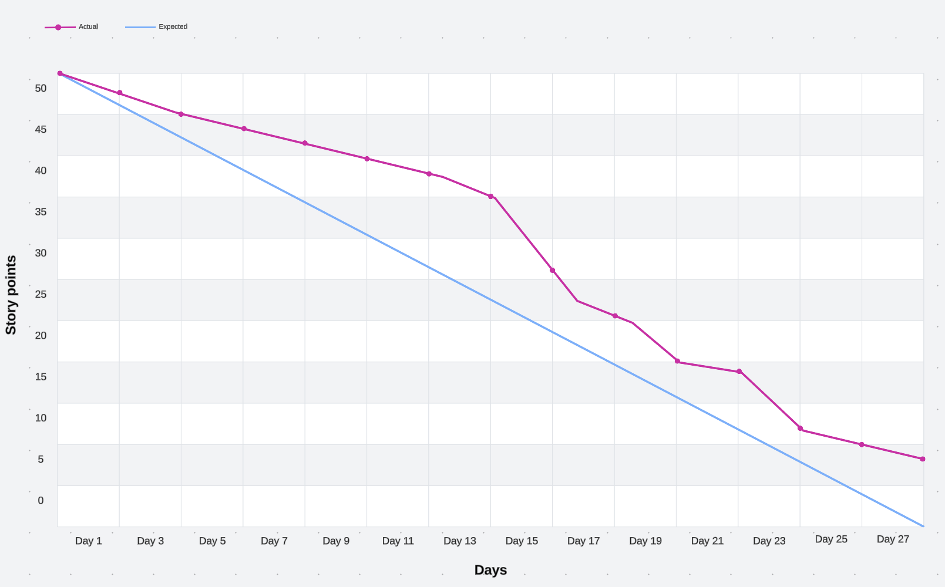
Burn down chart

Slide 48
Completed/Committed Ratio – Sprint 2
Sprint 2 Metrics:
Total Story Points Committed: 50 points
Total Story Points Completed: 42 points
Calculation:
Completed/Committed Ratio = (Total Story Points Completed / Total Story Points Committed) × 100
Completed/Committed Ratio = (42 / 50) × 100 = 84%

Slide 49

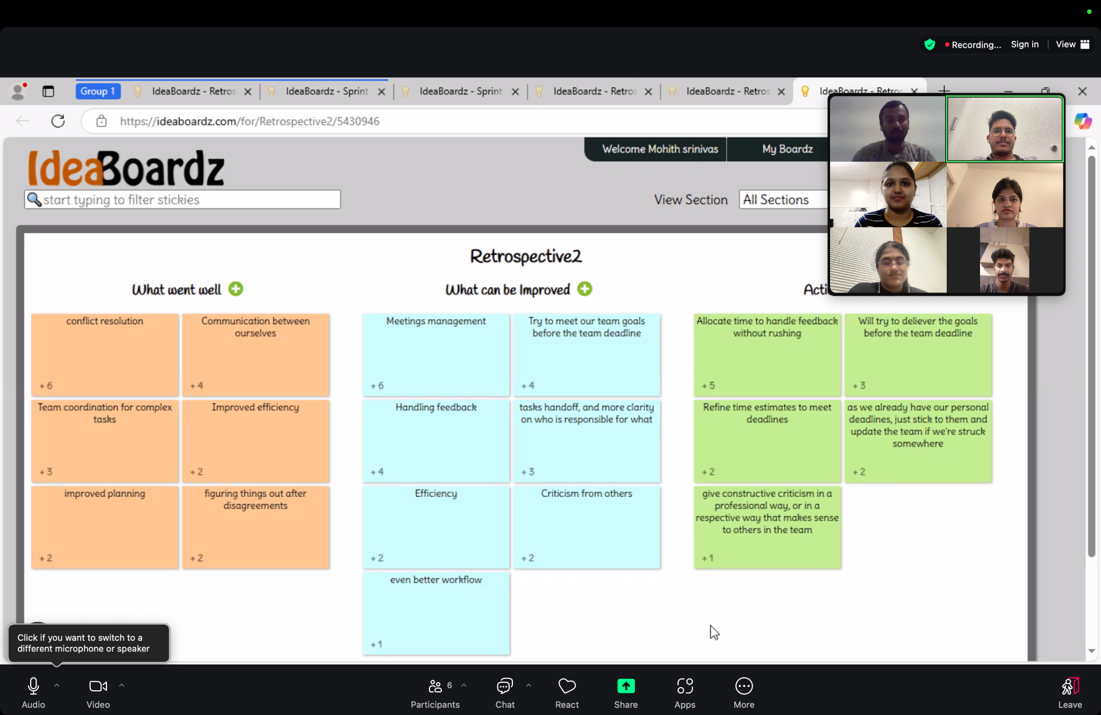
RETROSPECTIVE

Slide 50

Sprint 3 Planned
Story ID | Story Points | User Story/Task Description | Acceptance Criteria
TS2.2 | 8 | Carried Over: As a UI developer, I want to build an interface for future date outfit planning and customization. | 1. UI for selecting future dates and customizing outfit preferences. 2. Seamless outfit planning experience.
US3.1 | 8 | As a business professional, I want to create an account and log in to save my preferences and outfit history. | 1. Account creation with basic details. 2. Secure login/logout. 3. Saving and retrieval of outfit preferences and history.
US3.2 | 5 | As a weather enthusiast, I want to view previous outfit suggestions for future reference. | 1. View outfit suggestions based on past weather. 2. Save suggestions for specific dates/locations.

Slide 51
Sprint 3 Planned
Story ID | Story Points | User Story/Task Description | Acceptance Criteria
US3.3 | 8 | As a traveler, I want to receive tailored outfit suggestions based on past choices and preferences. | 1. Personalized outfit suggestions based on past selections and weather data.
TS3.1 | 5 | As a security-focused developer, I want to implement a simple user authentication system. | 1. Secure user registration and login system. 2. Storage of preferences and outfit history.
TS3.2 | 8 | As a UI/UX finisher, I want to finalize UI/UX improvements and make the website fully responsive. | 1. Enhanced UI/UX. 2. Full responsiveness on all devices.

Slide 52
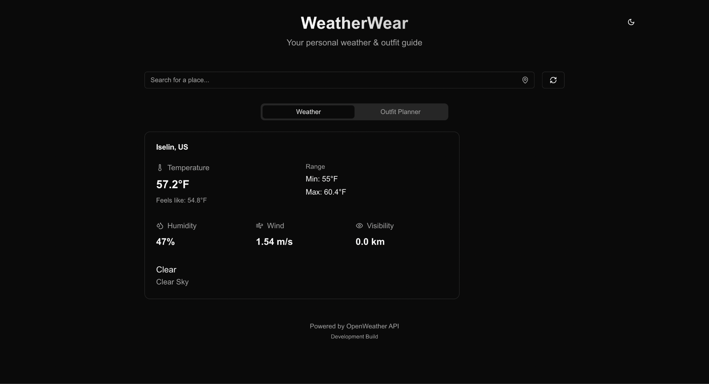
PROJECT DEMO

Slide 53
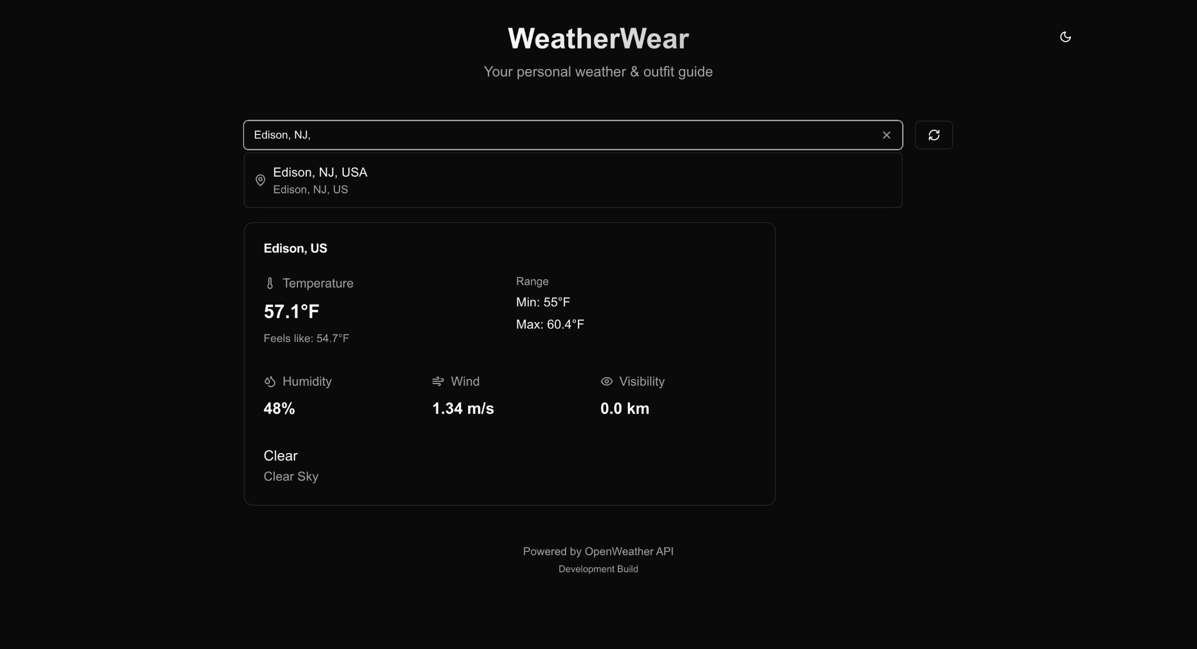
PROJECT DEMO

Slide 54
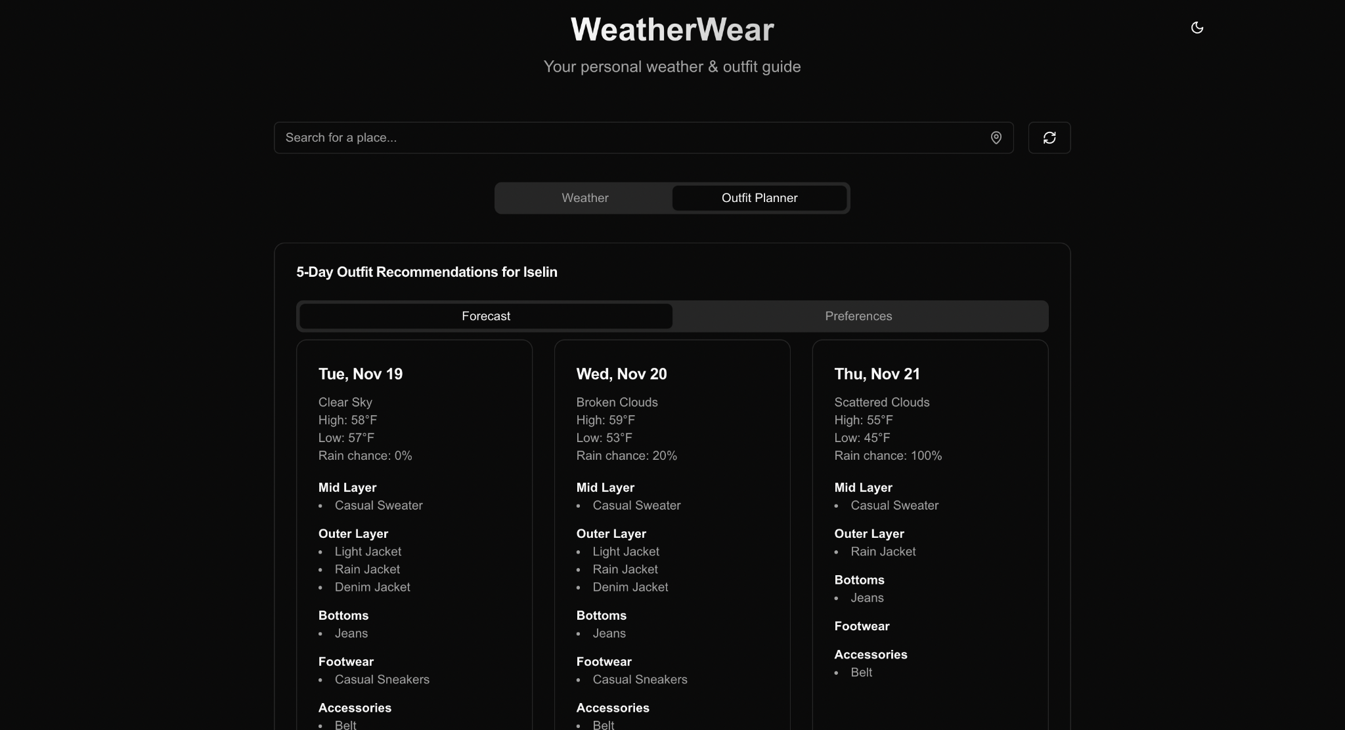
PROJECT DEMO

Slide 55
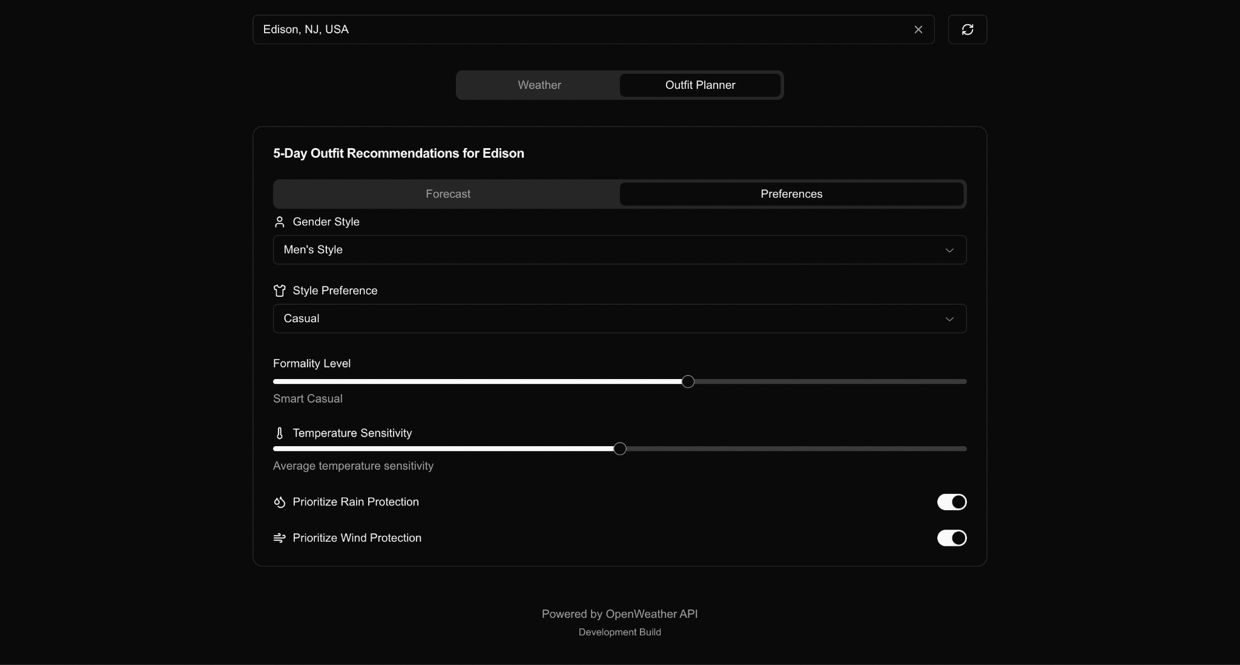
PROJECT DEMO

Slide 56
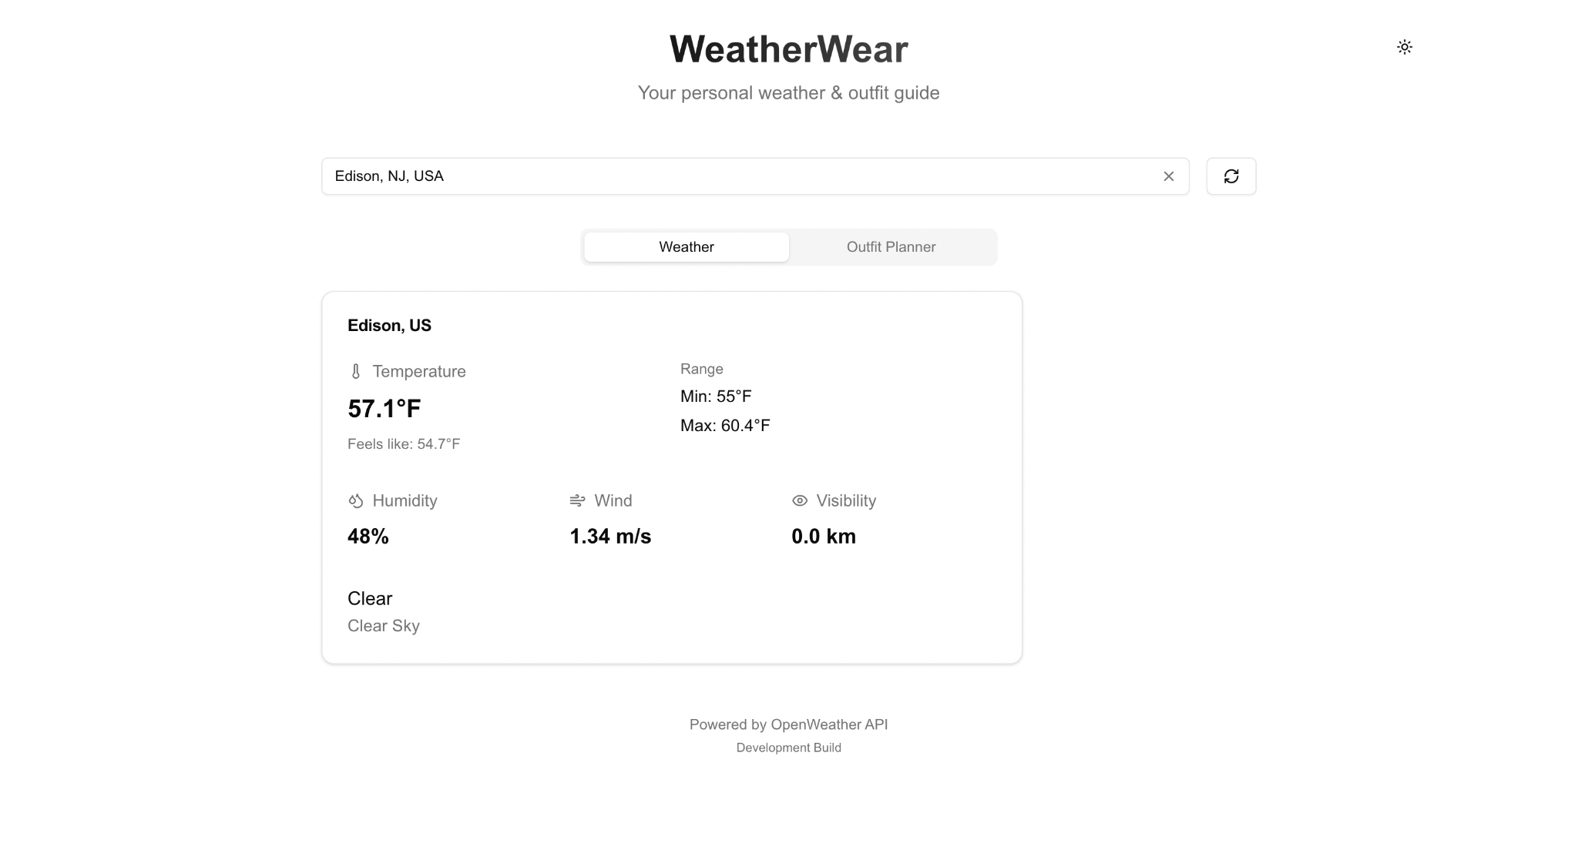
PROJECT DEMO

Slide 57
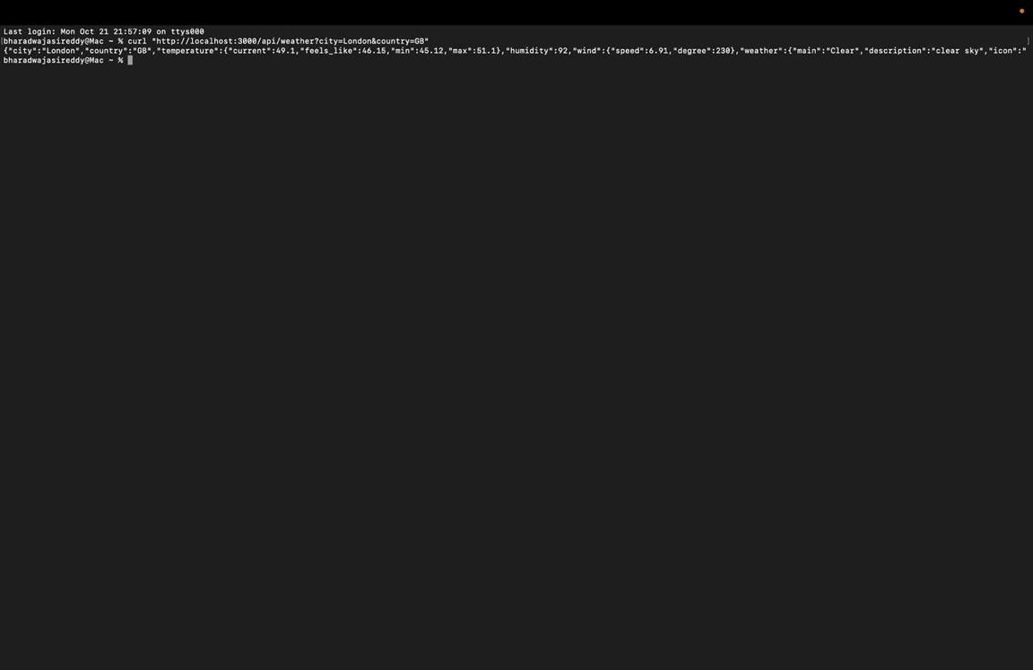
API

Slide 58
GITHUB LINK
https://github.com/htmw/2024F-Bad-Ideas/wiki

Slide 59
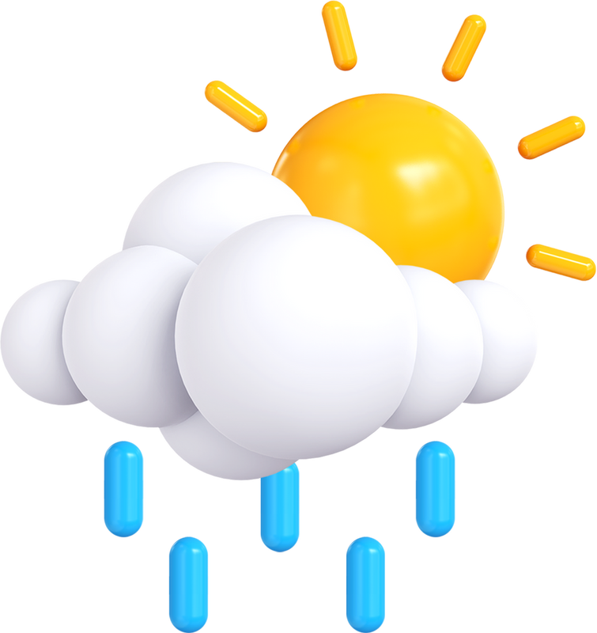
THANK YOU

